Slide 1
Chapter 15
Mixed Economic System
Enquiry question
To what extent should governments intervene in the allocation of resources.
The extent to which the goal of economic efficiency may conflict with the goal of equity.

Slide 2
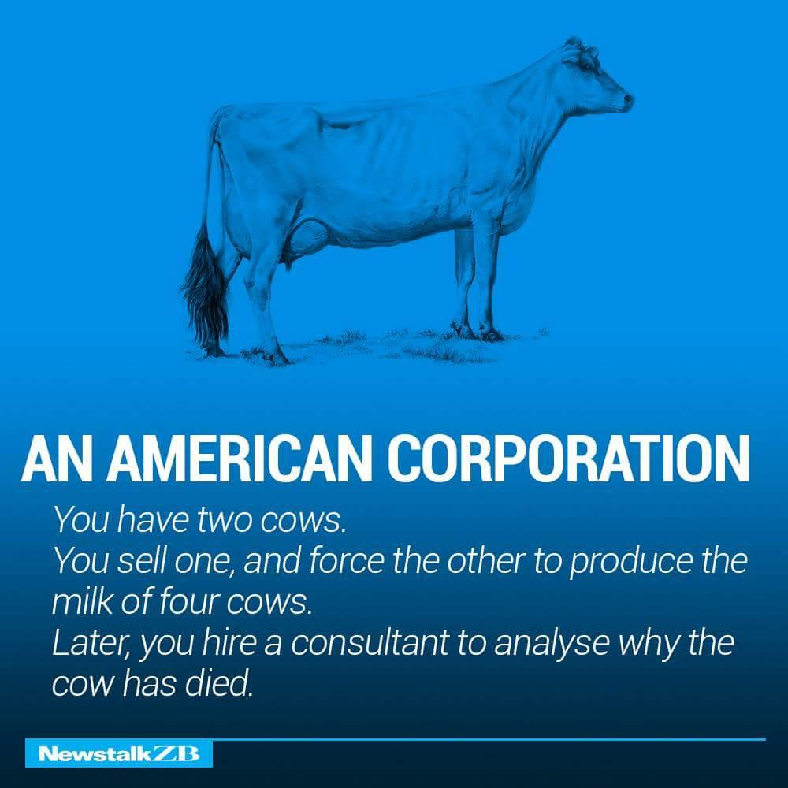

Slide 3
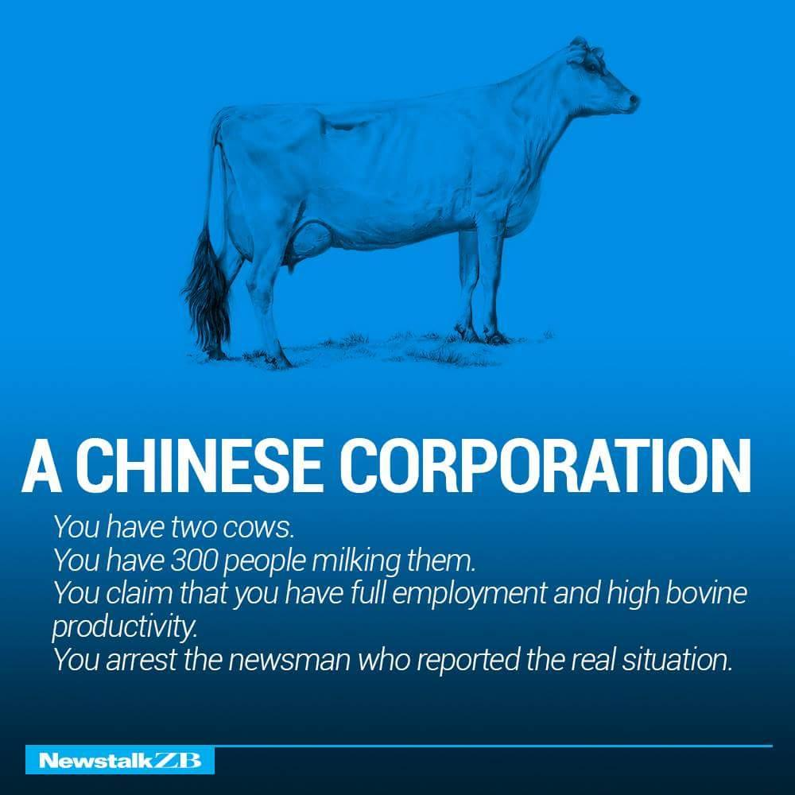
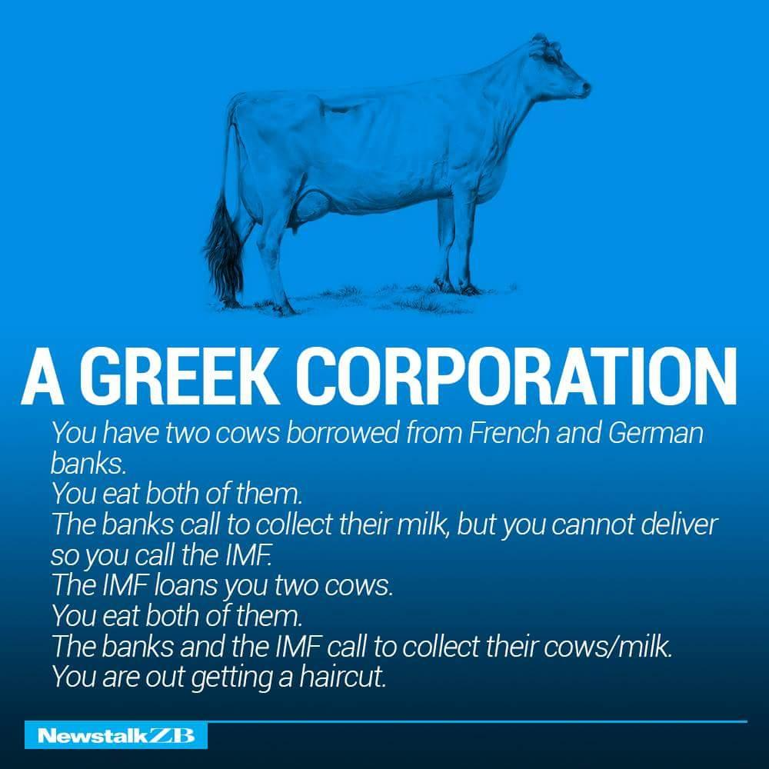

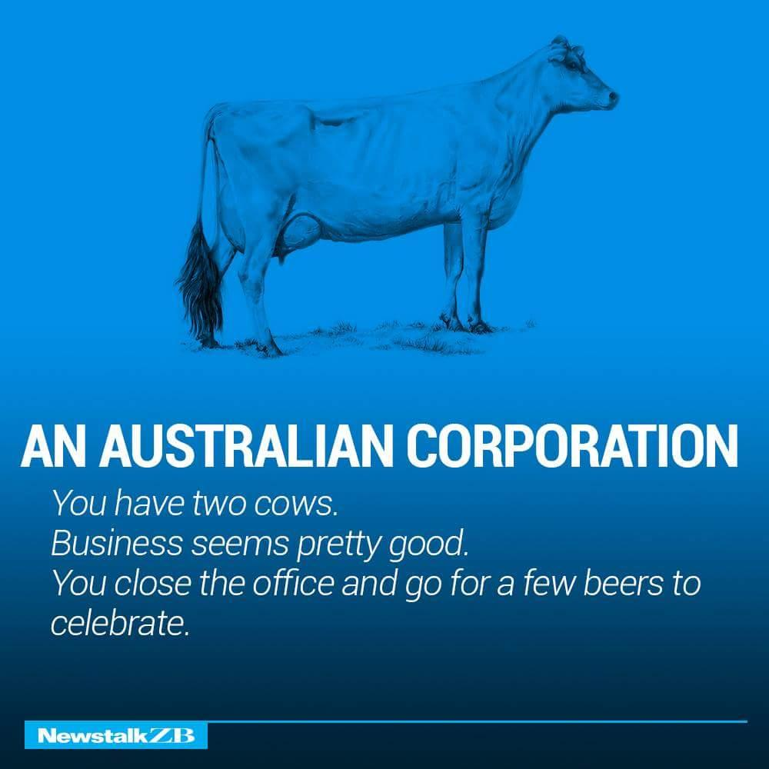

Slide 5
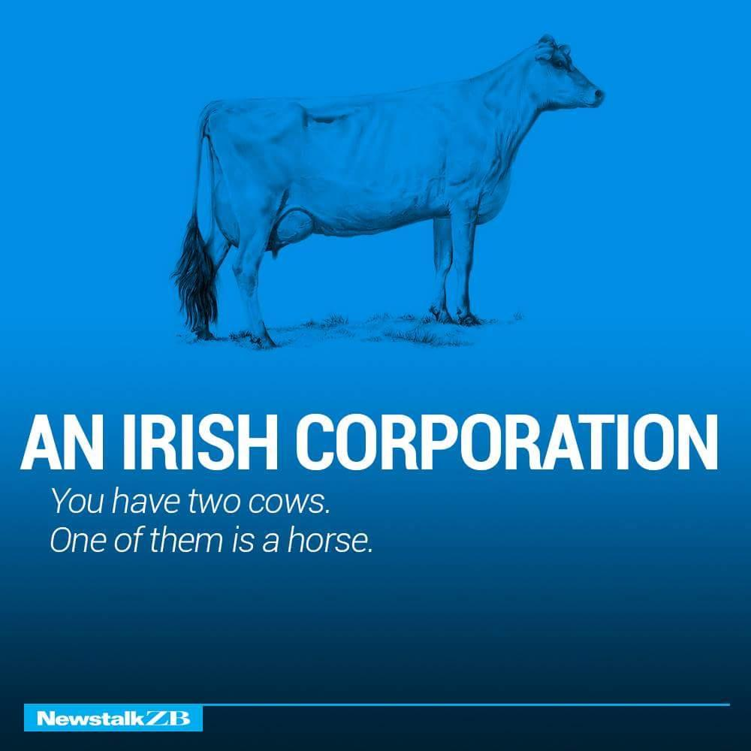

Slide 6
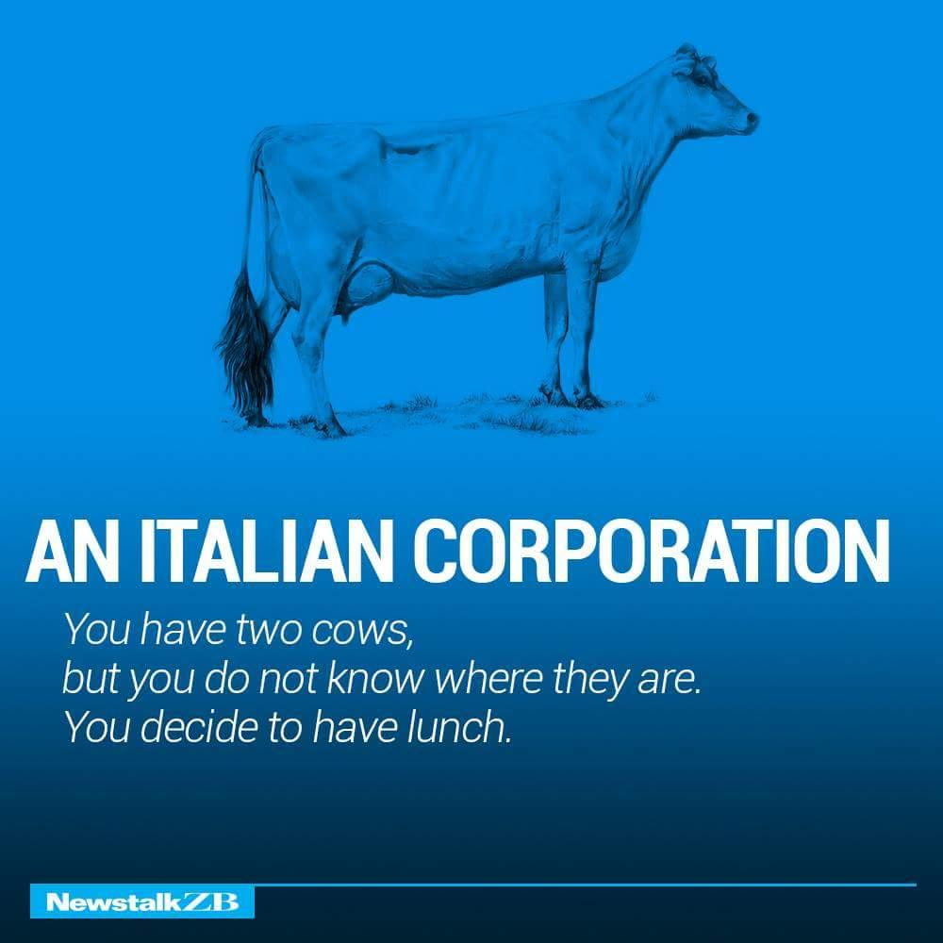

Slide 7
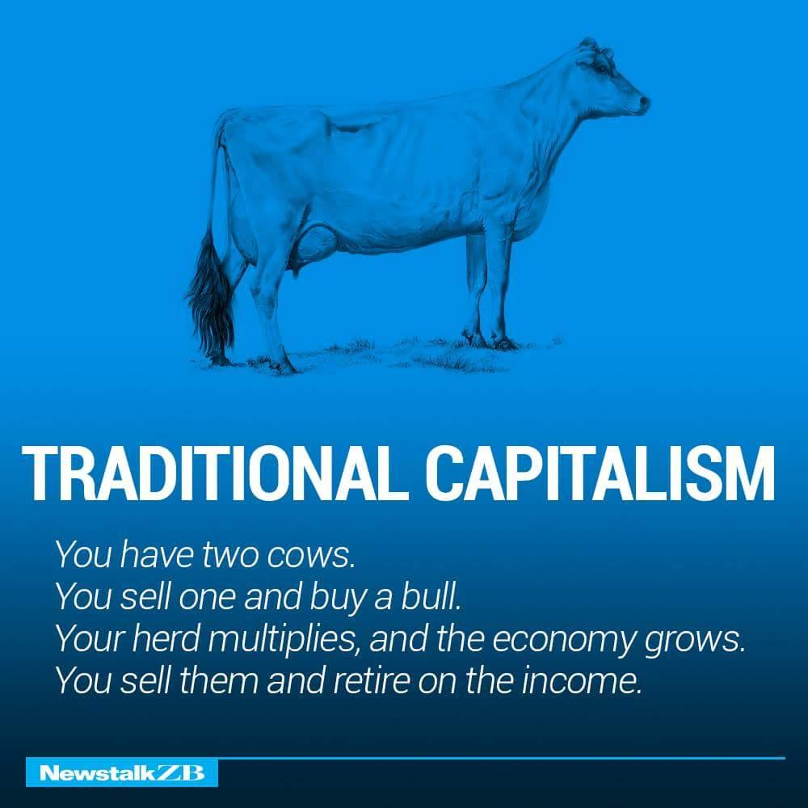

Slide 8
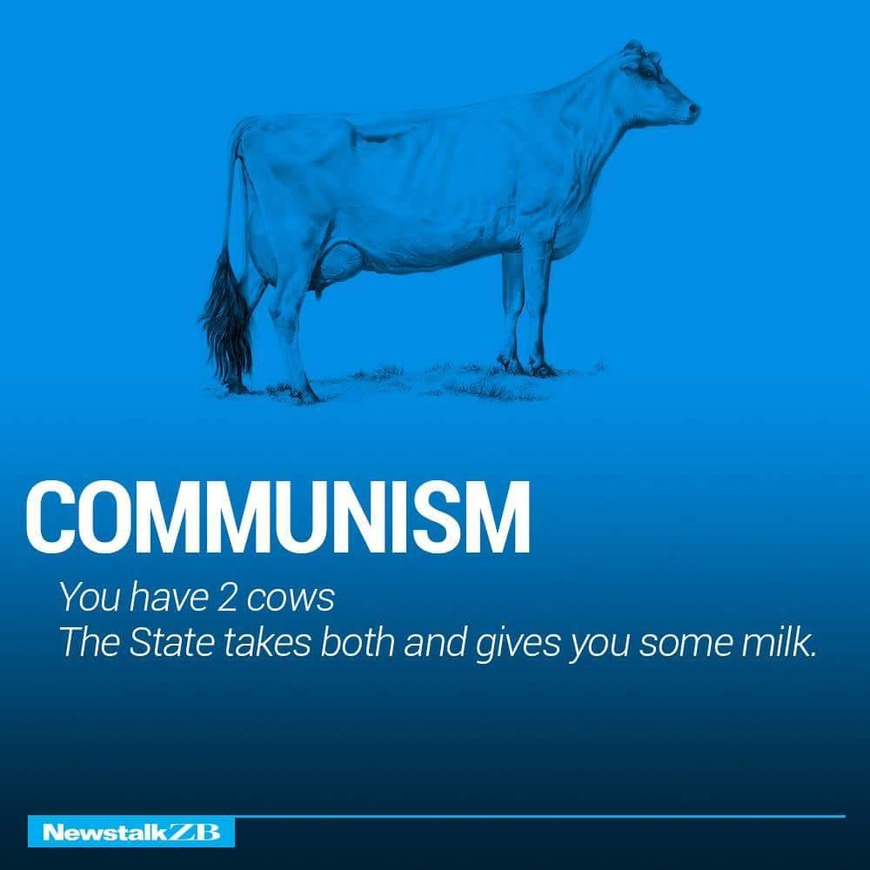

Slide 9
Which system do you believe offers the best life for its citizens?
Write down 3 reasons

Slide 10
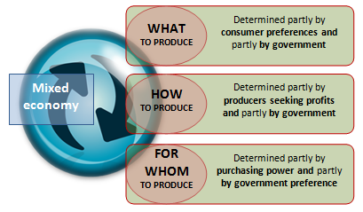
A mixed economy is an economic system that incorporates aspects of more than one economic system. This usually means an economy that contains both privately-owned and state-owned enterprises or that combines elements of capitalism and socialism, or a mix of market economy and planned economy characteristics. This system overcomes the disadvantages of both the market and planned economic systems.

Slide 11
The mixed economic system
In a mixed economy a government can intervene in different markets in an attempt to correct the worst market failures:
It can provide useful and essential goods and services (Public goods) (defence) that cannot be charged directly
Encourage consumption of products that are more beneficial for consumers (e.g healthily life style & foods) by granting subsidies/ providing Information (ads) /passing laws (drinking age/motorcycle helmet )
Discourage consumption of products that are harmful goods and dangerous activities such as taxes, providing education/information, legislation
It can provide goods and services for people in the greatest need (rail line even if not make a profit run under private firm, if social benefits more than the cost ) & (Merit goods)
It can employ people in public sector organizations & Welfare payments
Provide financial support to private sector firms (financial Crisis) to boost output (Food /Energy production) and employment
It can outlaw business practices that restrict competition (high price) or mislead consumers
Consumers & Firms only consider private costs & Benefits (Demerit goods) pollution/waste
Governments can plan ahead than private firms may devote more resources to capital goods
Help vulnerable groups have access to essential services
Distribute income by use progressive income tax

Slide 12


The mixed economic system
A mixed economy therefore combines the advantages of a market economic system with:
government ownership and control of some scarce resources | government interventions to regulate the actions of private sector firms and consumers in some markets

Slide 13
Government intervention: some problems
By correcting failures in some markets, a government may distort the allocation of resources and cause problems in others:
High taxes on people and firms can distort market price signals and reduce work incentives
Land regulations can increase production costs and therefore reduce the profitability and supply of some goods and services
Public sector organizations may be inefficient and produce poor-quality goods and services because they do not have to make a profit
Some government spending may be for political (re-election) or even personal gain (Corruption)

Slide 14
Governments tend to intervene often to influence several variables in markets for particular goods, such as:
Taxing the good to discourage consumption or raise revenues: Indirect taxes
Paying producers of the good to reduce costs or encourage the good’s production: Subsidies
Reducing the price of the good below its free market equilibrium to benefit consumers: Price Ceilings
Raising the price of a good above its free market equilibrium to benefit producers: Price Floors
When governments intervene in the free market, the level of output and price that results is may NOT be the allocatively efficient level. In other words, government intervention may lead to a misallocation of society’s resources.
Notes:
The Role of Government in the Market Economy
Up to this point, we have examined how free markets work.
A free market is one without any government control or intervention. The price and output is determined by the interactions of buyers and sellers

Slide 15


Slide 16
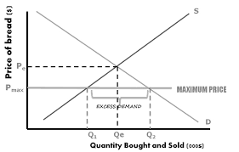
Maximum price/Price ceiling
The government or an industry regulator can set a maximum price to prevent the market price from rising above a certain level.
One aim of this might be to prevent the monopolistic exploitation of consumers
To be effective, a maximum price has to be set below the free market price.
One example might be when shortage of foodstuffs threatens large rises in the free market price.
Other examples include rent controls on properties – for example the system of rent controls in Manhattan in the United States.
Price capping also happens when the competition authorities judge that consumers are being exploited by businesses using their monopoly power. For example, the EU has introduced price caps for roaming charges on consumers made by the mobile phone service providers
A maximum price seeks to control the price – but also involves a normative judgement on behalf of the government about what that price should be.

Slide 17
Disadvantage of Maximum price
Black markets develop where there is excess demand. Some consumers are prepared to pay higher prices in black markets in order to get the goods or services they want.
Rationing when there is a market shortage
Rationing when there is a maximum price might also be achieved by allocating the good on a
'first come, first served' basis – e.g. queues of consumers.
Use of lottery drawing of tickets for goods
Both of these ways of rationing goods might be considered as inequitable (unfair) – because it is likely that eventually those who might have the greatest need for a commodity are unlikely to have their needs met.

Slide 18
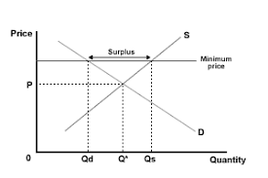
Minimum prices
Minimum prices are price floors and are most commonly associated with minimum wages in the labour market ( protect workers ensuring workers earn enough to lead a reasonable existence.)
or guaranteed price support schemes for farmers or other producers.
The Disadvantage of Minimum Wages
Unemployment. a minimum wage could cause unemployment because firms will demand less labour,
higher wages may encourage more workers to supply their labour.
Cost-push inflation, this is because firms face an increase in costs which are likely to be passed on to consumers.
The Disadvantage of Minimum Prices (Agricultural goods)
Higher prices for consumers. We have to pay more for food.
May encourage oversupply and inefficient. The CAP(common agricultural policy in EU) encouraged farmers to produce food that no one actually wanted to eat.
Over-supply Government need to purchase excess supply to store or export(this may have problems)

Slide 19
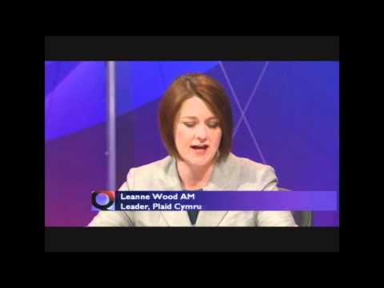

Slide 20
1. Draw the impact of the minimum price on a supply and demand curve. Presume that the price floor is placed above the equilibrium level and show the impact on price and consumption levels.
2. Explain two other measures that a government could employ to reduce alcohol consumption within communities.
3. Evaluate the advantages and disadvantages of the minimum price legislation?

Slide 21
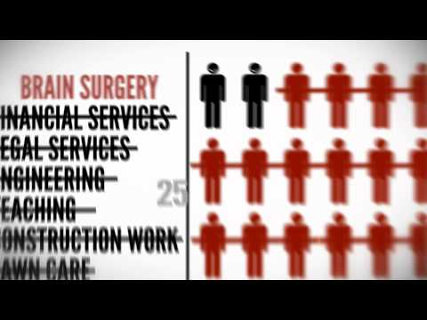

Slide 22
Taxes
Direct
Indirect
A tax on income/Profits
A tax on expenditure
Income Tax / Corporate/Business tax
Ad- Valorem (Percentage)
Flat (Specific)
An indirect tax of an absolute (constant) amount levied per unit of a commodity ex: a tax of $5 per unit.
An indirect tax, which is expressed as a proportion (percentage) of the price

Slide 23
The main reasons for government imposing taxes can be:
To generate Government revenues: excise duties on beers, wines and spirits are price inelastic in demand, so tax price increases by levying specific alcohol and tobacco taxes raise consumer expenditures as a whole on these categories and therefore taxation revenues;
To discourage consumption: Government might use taxes to discourage consumption of certain demerit goods such as cigarettes.
To alter the pattern of consumption: Government might use direct taxes a a mean to alter the consumption patter of its population. Certain goods can be made more price attractive through lower taxes while goods which have high marginal social cost can be made expensive through taxation.
Notes:
Excise taxes can be used to redistribute income: Some excise taxes focus on luxury goods (expensive cars, boats, furs, jewellery). The is to tax goods that can only be afforded by high-income earners.
Payment of a tax on the purchase of these goods reduces after-tax income,
Some degree of income redistribution is achieved as income inequality is narrowed.
Excise taxes are a method to improve the allocation of resources (reduce allocative inefficiencies) by correcting negative externalities.

Slide 24
Indirect Taxes
An indirect tax is a tax on spending
Government taxes the firm which increases its costs
The supply curve shifts vertically by the amount of the tax
Less product is supplied at every price
The price increase
Causing less quantity demand
This diagram illustrates a specific tax
The shift is vertically upward of the amount of the tax
An example would be the tax on a packet of cigarettes
Indirect tax – tax on expenditure
S + tax
Price
S
tax
P2
P1
D
Q2
Q1
Quantity
specific tax – a fixed amount of tax that is imposed on a product e.g. $1 per unit

Slide 25
Indirect Taxes
An indirect tax is one placed by the government on the producers of a particular good.
Consumers will pay the tax indirectly through producers
An indirect tax will be shared by both consumers and producers
The effect of an indirect tax on the market for a good: Examine the market for pencils.
Assume the government decides to place a $0.50 tax on pencil production to raise revenue to support the pen industry.
The tax is an additional cost for pencil producers, so the supply of pencils decreases.
Supply will shift UP by $0.50
The price of pencils increases from $1.25 to $1.55.
Once the tax is paid, pencil producers get to keep just $1.05
Pencil market
P
S_{+tax}
S
1.55
$0.50
1.25
1.05
D
Q_{tax}
Q_{e}
Q

Slide 26
Sales tax can be divided into general sales taxes applied to all goods and services and specific taxes on certain products, that the government wishes to reduce the consumption of. Examples might include taxation placed on tobacco and alcohol products while some governments place taxes on luxury goods imported from overseas.
Research the goods and services that your government places a specific tax on and decide the likely motivation for the tax?

Slide 27


Slide 28
Now watch the following short video which argues that the production of marijuana should be legalised and then subject to a sales tax, just as cigarettes and alcohol are under the current law in America.
Summarise the main arguments for and against the legalisation of this product? Has the video in anyway changed you opinions on the merits of legalising the product?

Slide 29
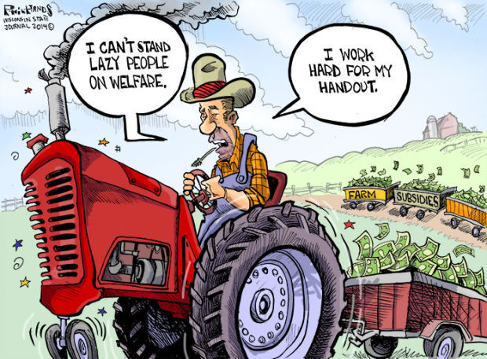

Subsidy
An amount of money paid by the government to producers or consumers per unit of output.
A subsidy has an opposite effect of a tax.
Subsidies may be regarded as negative indirect taxes.

Slide 30
Subsidies can be used to encourage production and consumption of particular goods and services that are believed to be desirable for consumers.
Subsidies can be used to make certain goods (necessities) affordable to low-income consumers.
Subsidies can be used to support the growth of particular industries in an economy.
Subsidies can be used to increase revenues (and hence incomes) of producers.
Why governments grant subsidies
Subsidies can be used to encourage exports of particular goods.
Subsidies are a method to improve the allocation of resources (reduce allocative inefficiencies) by correcting positive externalities.

Slide 31
Government Intervention
Subsidies
Different Types of Producer Subsidy
A guaranteed payment on the factor cost of a product – e.g. a guaranteed minimum price offered to farmers such as under the old-style Common Agricultural Policy (CAP).
An input subsidy which subsidises the cost of inputs used in production – e.g. an employment subsidy for taking on more workers.
Government grants to cover losses made by a business – e.g. a grant given to cover losses in the railway industry or a loss-making airline.
Bail-outs e.g. for financial organisations in the wake of the credit crunch
Financial assistance (loans and grants) for businesses setting up in areas of high unemployment – e.g. as part of a regional policy designed to boost employment.

Slide 32
Government Intervention
Subsidies
Economic and Social Justifications for Subsidies
Why might the government be justified in providing financial assistance to producers in certain markets and industries? How valid are the arguments for government subsidies?
To keep prices down and control inflation – in the last couple of years several countries have been offering fuel subsidies to consumers and businesses in the wake of the steep increase in world crude oil prices.
To encourage consumption of merit goods and services which are said to generate positive externalities (increased social benefits). Examples might include subsidies for investment in environmental goods and services.
Reduce the cost of capital investment projects – which might help to stimulate economic growth by increasing long-run aggregate supply.
Subsidies to slow-down the process of long term decline in an industry e.g. fishing or mining
Subsidies to boost demand for industries during a recession e.g. the car scrappage scheme

Slide 33
Per-unit Subsidies
The effect of a per-unit subsidy on the market for a good: Assume the government places a $0.50 subsidy on the production of pens.
Supply shifts ‘down’ by $0.50, since the subsidy reduces the marginal costs of pen producers.
The price consumers pay falls from $2 to $1.70.
The price producers receive for each pen is the $1.70 consumers pay plus the $0.50 subsidy, or $2.20
There is a greater quantity of pens produced
Pen market
P
S
S_{+subsidy}
2.20
2.00
$0.50
1.70
D
Q_{e}
Q_{subsidy}
Q

Slide 34
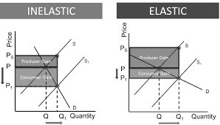
The effect of subsidy with elastic demand for a good:
If demand is elastic, then a subsidy causes a bigger percentage rise in demand.
There is only a small fall in price.
In this case, producers benefit from the subsidy because their producer surplus increases more than consumer surplus
The effect of subsidy with inelastic demand for a good:
Supply shifts ‘down’ produces passed most of the subsidy for extension of demand.
If demand is price inelastic, then a subsidy causes a substantial fall in price, however there is only a small increase in demand.
Consumers getting most of the benefit
However less quantity is consumed

Slide 35
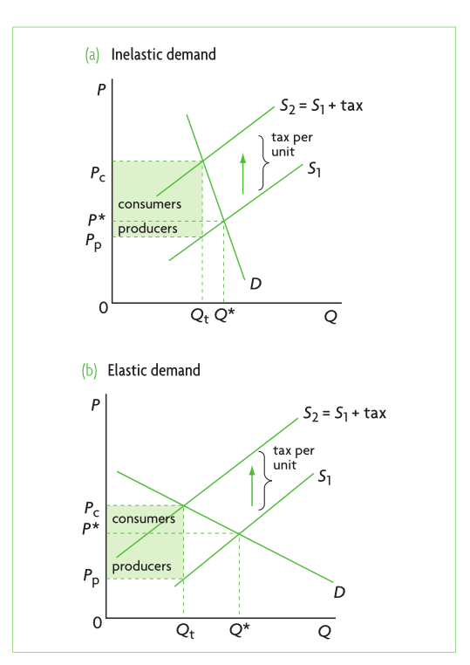
Indirect tax PED Inelastic
Now we will look at what happens when the PED is relatively inelastic and the PES is elastic
Initially equilibrium is at P*Q*
With the specific tax of the supply curve shifts to S2_{+tax}
There is a new equilibrium of P_{c}Q_{t}
The consumer pays P*PC in tax
The producer pays P* Pp in tax
We can see that the consumer is paying much more of the tax
This is because the PED is inelastic; the firm knows that if the consumer is not sensitive to price; if the price is increased the consumer % demand will not change as much as the % change in price
The consumer bears most of the burden of the tax
Therefore higher the tax greater the impact on price than quantity sold

Slide 36
Evaluation of Subsidies
Opportunity cost as funds used for other purposes eg health/education/infrastructure
Government may need to raise a significant amount of tax revenue to pay for subsidies.
Firms can become inefficient if rely on subsidies
Evaluation of taxes
So, for a government wishing to raise revenue from indirect taxation, they will always tend to impose the taxes on goods with relatively inelastic demand.
The more inelastic the demand, the more the price will rise and therefore the more of the tax will be passed on to the consumer. Thus more revenue
Are tobacco, alcohol, petrol PED elastic or inelastic? Are they taxed highly or not taxed?
So we can see that if we tax a good with elastic demand, then the price will rise very little and the tax will fall mainly on the producer (as they are not able to pass on the tax as a price increase).
If, however, the good is inelastic in demand the producer will be able to increase the price more and therefore pass on more of the tax as a price increase. In this situation the burden of the tax falls mainly on the consumer.

Slide 37
Advantages of using tax:
Tax revenue can be used to compensate affected third parties and to pay for the negative consequences of an externality. For example, the tax revenue from cigarettes can be used to pay for some of the healthcare costs of people who smoke.
Increasing price is an effective way of reducing consumption and production.
Disadvantages of using tax:
Tax can reduce the welfare of low-income groups where the price of a good is significant proportion of their income. For example, a tax on petrol can have a significant impact on the incomes of poorer households who rely on their cars.
Increasing business costs can lead lower business profits and even business failure. Increasing tax can be particularly significant for small businesses.
If business costs rise in industries such as energy this could lead to a higher average price level in the economy and increase inflation.
The tax can make domestic firms uncompetitive on international markets and lead to a fall in exports.
If business output decreases because of the increase in tax it can cause unemployment to rise in an industry.

Slide 38
Competition Policy in Markets and Industries
The main aims of competition policy are to promote competition; make markets work better and contribute towards improved efficiency in individual markets and enhanced competitiveness of businesses within the market.
Competition policy aims to ensure
Technological innovation which promotes dynamic efficiency in different markets
Effective price competition between suppliers
Safeguard and promote the interests of consumers through increased choice, better quality and lower price levels
Merger control: This involves the investigation of mergers and take-overs between firms (e.g. a merger between two large groups which would result in their dominating the market)
Introducing competition such as removal of barriers to markets in previously monopolistic sectors such as energy supply, retail banking, postal services, mobile telecommunications and air transport
Antitrust & cartels: This involves the elimination of agreements that restrict competition including price-fixing and other abuses such as Predator pricing by firms who hold a dominant market position (defined as having a market share in excess of forty per cent)
Predatory pricing is the illegal act of setting prices low in an attempt to eliminate the competition. Predatory pricing makes markets more vulnerable to a monopoly.

Slide 39
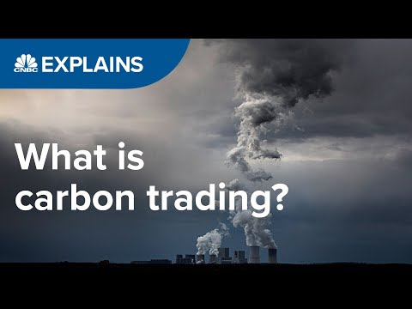

Slide 40
Environmental Policies
Implementing regulations, legislations, codes of practice, taxes are just some ways of how governments can protect the environment. By doing this, they prevent companies from doing harmful things to the environment legally.
A carbon tax imposes a tax on each unit of greenhouse gas emissions and gives firms an incentive to reduce pollution whenever doing so would cost less than paying the tax.
A cap-and-trade system sets (tradable permits) a maximum level of pollution, a cap, and distributes emissions permits among firms that produce emissions.
Companies must have a permit to cover each unit of pollution they produce, or through trading with other firms.
Since some firms inevitably find it easier or cheaper to reduce pollution than others, trading takes place. Which will lead to efficient firms selling goods much cheaper thus increasing market share and lowering pollution.

Slide 41
Very positive effects in certain cases such as legislation requiring schooling up to a minimum age or advertising on the importance of good nutrition.
If public discussions of sexual behaviour is considered offensive
Subject to similar limitations concerning calculating the size of external benefits. (what measures to be put in place) for the spill-over effect
Legislation and advertising
legislation and advertising sometimes can be used more effectively if they are implemented together with direct provision and subsidies.
E.g. education, where compulsory schooling up to a certain age (legislation) goes together with direct government provision.

Slide 42
Cost in enforcing & advertising
Do not directly compensate those affected affected by market failure
May reduce market flexibility & create barriers to entry
Legislation and advertising
Can be ineffective e.g., cannot on their own increase consumption of health care services and education to the optimum level.
May have the further effect of raising the price of the good to consumers (unaffordable for some consumer groups)

Slide 43
Nationalisation and privatisation
Nationalisation is the process by which governments take a private business into public ownership.
In the UK, the period 1947–51 saw the extensive nationalisation of transport, fuel, power and the iron and steel industries.
Some manufacturing businesses – such as shipbuilding, aerospace, vehicle production and sugar beet processing – followed this trend.
Many countries in the world have nationalised their railways, airlines, mining, electricity and water industries as well as, more recently, banks and financial services.
Public corporations:
A business owned by the government and run by Directors appointed by the government. These businesses usually include the water supply, electricity supply, etc. The government give the directors a set of objectives that they will have to follow:
to keep prices low so everybody can afford the service.
to keep people employed.
to offer a service to the public everywhere.

Slide 44
Advantages of Public Corporations
With a public corporation, every decision will be made after considering the benefits and full costs.
Public corporations can be used to impact a country's economic activity.
Government may encourage a public corporation to boost their output in order to increase the overall output of the country. (GDP)
In an industry where having only one firm makes (Utilities) the most sense, a public corporation won't abuse its power.
When a government owns an entire industry, it simplifies coordination and planning.
For example, if the government operates a country's train system, it can coordinate timetables to make sure that the trains run on time.
For essential industries such as transportation and electricity, it is important that prices remain low and quality remains high, which is why many industries rely on public corporations.
Using public corporations in this way can benefit the general public by:
Improving quality of service.
Lowering prices.
Stabilizing prices.
which can be a concern with private corporations.

Slide 45
Disadvantages of Public Corporations
Difficult to manage
The most noteworthy disadvantage of public corporations is that these organizations are extremely difficult to manage. Because public corporations are so large, the process of making decisions can be very slow as it takes longer to hold meetings and communicate with staff.
Inefficiency and Poor Quality
Inefficiency is also a potential disadvantage of a public corporation. Because public corporations know that they have little to no competition (NO INCENTIVE) , are acting as a monopoly, and are unable to go bankrupt, they may offer low quality products for expensive prices.
Restrictive Access to Revenue
If a public corporation is losing instead of making money, they may need to be subsidized. When tax revenue is needed to support a failing corporation, it means this revenue cannot be used for other vital purposes such as training.
The losses of public corporations are often subsidized by the government, and if this occurs regularly, it can take a huge toll on government finances. This can be particularly disastrous for developing nation.
Lack of Flexibility and Independence
Public corporations must deal with almost constant political interference and may need to satisfy the wishes of politicians.
Potential for Corruption

Slide 46
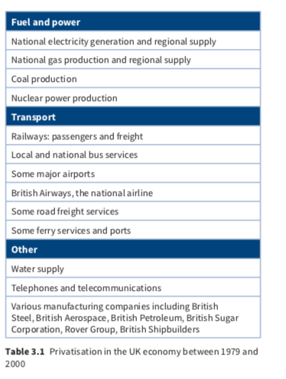
Taking the UK economy as a particular example, it is possible to recognise various reasons for the extensive privatisation shown in Table 3.1. Some are economic, others much more concerned with political motivation. For example:
■ a deliberate commitment to reduce government involvement in the economy
■ to widen share ownership among the population and among the employees of the privatised companies
■ benefits for consumers in the form of lower prices, wider choice and a better quality product or service
■ the sale of nationalised industries has generated substantial income for the UK government over a long period of time. This has been estimated to be £70–80 billion
■ privatised companies can be successful in raising capital, lowering prices and cutting out waste; they are more efficient than state-owned operations.

Slide 47
Advantages of state provision:
Government provision of public goods is the only way they can be produced. Remember the free market will not generate a price that can support the production of a public good.
Government are more likely to provide quasi-public goods near the socially efficient output.
When the government is providing a public good it is more likely to make decisions in the public interest compared to private sector businesses that aim to make a profit. This could be important in the provision of quasi-public goods such a parks. ,
Governments can provide public goods at zero price so they are available to low-income households.
Disadvantages of state provision:
The cost of providing state funded and managed public goods is extremely high and there is a significant opportunity cost to the government in terms of other areas of expenditure.
Some people question the efficiency of state-run organisations that provide public goods.
State managed and organised public goods can be influenced by political decision making which may not be in the best interests of society. For example, expenditure on defence can influenced by political rather than welfare factors.
It is impossible to accurately know the level of provision of the public good that is socially efficient.

Slide 48
Disadvantages of privatization
Firms may not face market forces
Privatization could still create a private monopoly which might seek to set higher prices, lower quality & quantities which exploit consumers. Therefore it is better to have a public monopoly rather than a private monopoly which can exploit the consumer.
Short-termism of firms
To please shareholders they may seek to increase short term profits and avoid investing in long term projects. For example, the UK is suffering from a lack of investment in new energy sources; the privatized companies are trying to make use of existing plants rather than invest in new ones.
Poor quality of goods & higher prices
Not take into account total costs & benefits to society such has pollution
Governments have less control in the economy

Slide 49
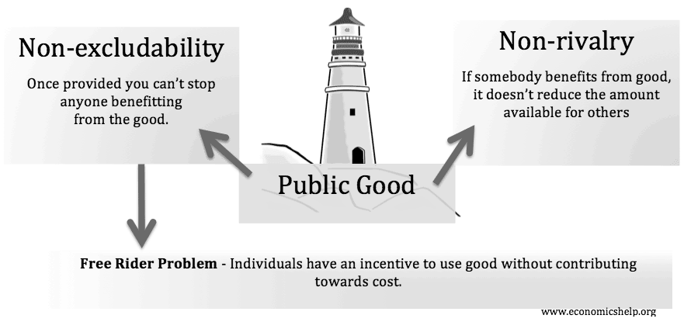
Direct provision of goods and services
Produce some G & S they think are essential
These are produced provided free or subsidized Housing that is affordable, health & education
If such services are used equally by all citizens, then those on lowest incomes gain most as a percentage of their income – thereby lowering inequality.
The two most common examples of such free provision in many economies are merit goods, such as health care and education. These markets are subject to various market failures. (merit goods) Under consumed
To stimulate consumption pay private to produce and provide information about benefits or make consumption compulsory
Public goods
Pure public goods are not normally provided by the private sector because they would be unable to supply them for a profit.
It is up to the government to decide what output of public goods is appropriate for society.
Financed through taxes
Private firms have no incentive to provide goods due t free rider problem.
Unable to change thus no profit

Slide 50
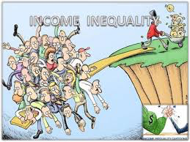
The prevalence of income inequality in free market economies
To intervene based on equity
Those who are born rich are more likely to become rich, while individuals who are born poor are more likely to live a life of relative poverty.
In a “free” market, it is believed, all individuals possess an equal opportunity to succeed, but due to a mis-allocation of resources in a purely market economy, this may not always be the case.
Private firms only produce goods that people are willing to pay for
The resources are those required for an individual to escape poverty and earn a higher income. Such as public and merit goods that those with high incomes can afford to consume
while those in poverty depend on the provision of from the state
Housing, education and health care.
Provision by state free such as education finance by taxation
Taxation & Benefits used to reduce income & wealth inequality
Higher income inequality leads to social and economic disruptions that can slow economic growth and productivity.
Poor people less healthy, less educated and less productive
Since the middle and lower income groups in the nation will not benefit from a relatively equal share of the nation’s output, and over time will see their living standards drop and their overall productivity and contribution to national output decline.
Social unrest

Slide 51
Arguments against government intervention
Governments liable to make the wrong decisions – influenced by political pressure groups, they spend on inefficient projects which lead to an inefficient outcome. E.g not to raise tax on fuel fear of loss of votes
Difficult to know what the size of the benefit of private benefit of the merit goods, thus may over provide using to many resources that could be used for public goods.
Higher taxes to fund to public goods/merit goods disincentive for working
High unemployment benefits disincentive to find jobs
High tax on entrepreneurs/firms disincentive on investment and thus expand

Slide 52


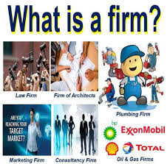
Who makes better decisions households & firms or governments ? For expenditure to be more efficient in allocation resources
Advantages & disadvantages
Building airport
Profit incentive & forces of competition will lead low costs and time efficient
Private firm may be a monopoly thus increase prices & low output and maybe poor quality
Private firms only take into account private costs & benefits
Government
State owned enterprises no incentive to keep price down
Not have experience to finish on time
Delays in government decisions may take time

Slide 53
Who makes better decisions households & firms or governments ? For expenditure to be more efficient in allocation resources
Positive it will evaluate all the social costs and social benefits in make the decision
Using Cost benefit Analysis (CBA)
For example Building Airport
Looking at all private costs (land, materials, wages, maintenance ) & benefits (Revenues earned)
Looking at all External Costs ( traffic congestion, pollution, noise pollution) & Benefits (increased employment, tourism more domestic firms & MNC may locate to area.
If MSC >MSB may not proceed
If MSB>MSC proceed
Governments do this analysis for many projects
Opportunity cost eg roads/health/education

Slide 54

Inquiry case example - French airline taxes
The French government is introducing an "eco-tax" on flights from all French airports. The aim of the tax is to try and combat some of environmental costs associated with air travel. The tax is expected to raise around €180m from 2020. For all Economy class tickets within France a tax of €1.50 is imposed and Business class tickets will have the highest rate of €18. The tax will also apply to outgoing flights from France but not to flights coming into the country. The money raised will be used to fund more environmentally friendly methods of transport such as trains and buses.
Question
Outline two reasons why the French government would impose of tax of the airline industry. [2]
Investigation
With your class investigate other markets where governments have become involved for environmental reasons.

Slide 55
Inquiry case example - The price of a beer in Iceland
Iceland has the most expensive beer in the world. The average pint of beer will cost you $12.75. The high price of alcohol in Iceland is largely down to tax. Alcohol is taxed by volume, which means the government would collect 94.1 percent of a bottle’s price for a one-litre bottle of vodka priced at $66. Iceland has a difficult relationship with alcohol and at times there have been periods of prohibition. This history is one of the reasons why alcohol is taxed so highly. An important benefit of this is the relatively low level of alcohol consumption and alcoholism in Iceland.
Questions
a. Define the term indirect tax. [2]
b. Outline the difference between an ad valorem tax and a specific tax. [2]
c. Explain the impact a specific tax on alcohol would have on consumers, producers and government. [10]
Investigation
Investigate the reasons why another country has a very high tax on a good or service.

